Slide 1
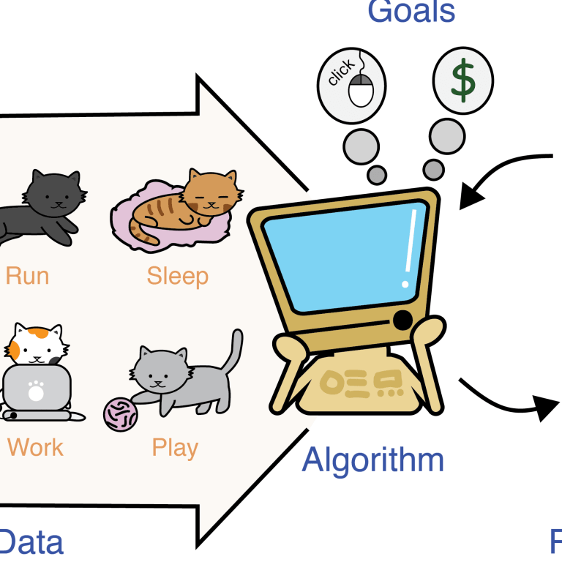


CS 6V81 - Independent Study Conceptual Modelling of Machine Learning for Exploring Machine Learning Techniques potentially preferable for Breast Cancer diagnosis
By Astha Thakur
Under the guidance of Professor Lawrence Chung

Slide 2
Flow of independent study process
1. What is Breast Cancer?
2. How common is breast cancer?
3. General observations on diagnosis
4. Diagnosis using ML : current practices
6. Systematic Review of Different ML Algorithms
7. Most preferable ML technique – SVM
9. What is SVM?
11. Breast Cancer classification using SVM
12. Attribute information and Features
13. Algorithm
14. Results
15. Improvements in the model
17. Summary
5. Cost-effectiveness of diagnosis using ML
8. SVM in detection of tumors
10. Advantages & Disadvantages of SVM
16. Risk of misdiagnosis

Slide 3

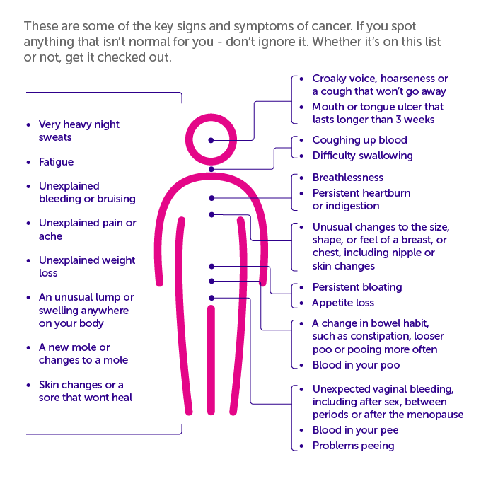
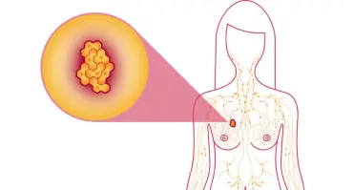
1. What is Breast Cancer?
Cancer begins with uncontrolled division of one cell, which results in a visible mass named tumor ^{[2]}.
Tumor can be benign or malignant ^{[2]}.
Malignant tumor grows rapidly and invades its surrounding tissues causing their damage ^{[2]}.
Breast cancer is a malignant tissue beginning to grow in the breast ^{[2]}.
There are over 200 different types of cancer that can cause many different signs and symptoms ^{[21]}.
Sometimes symptoms affect specific areas of the body. But signs can also be more general, and include weight loss, tiredness (fatigue) or unexplained pain ^{[21]}.
The symptoms of breast cancer include breast mass, change in shape and dimension of breast, differences in the color of breast skin, breast aches and gene changes etc ^{[2]}.

Slide 4
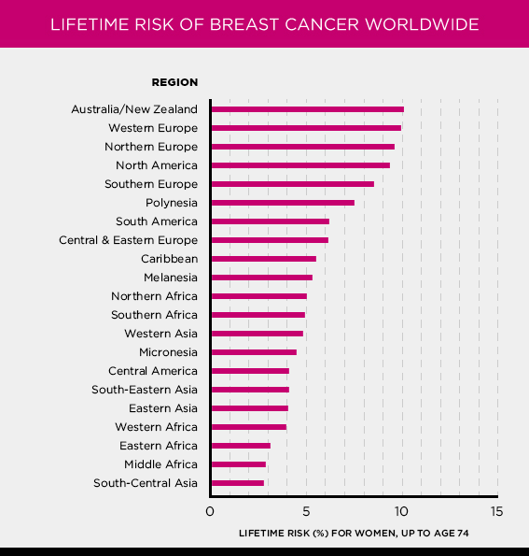

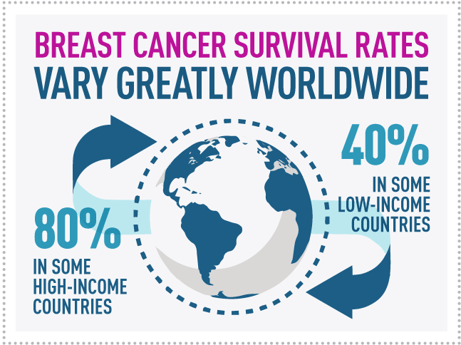
2. How common is breast cancer?
Breast cancer is the most common cancer in women both in the developed and less developed world ^{[3]}.
In 2012, it represented about 12 percent of all new cancer cases and 25 percent of all cancers in women ^{[15]}.
According to the report of the World Health Organization, about 1,000,000 women would be newly diagnosed with breast cancer and over 500,000 women died from breast cancer every year ^{[2]}.
Breast cancer is the most common cancer in women overall. It is the most frequently diagnosed cancer among women in 140 of 184 countries worldwide ^{[15]}.
In 2020, more than 2.3 million women were diagnosed with breast cancer worldwide and 685,000 died. Every 14 seconds, somewhere in the world, a woman is diagnosed with breast cancer ^{[15]}.
Breast cancer is the second leading cause of death for women all over the world and more than 8% women will suffer this disease during their lifetime ^{[2]}.

Slide 5
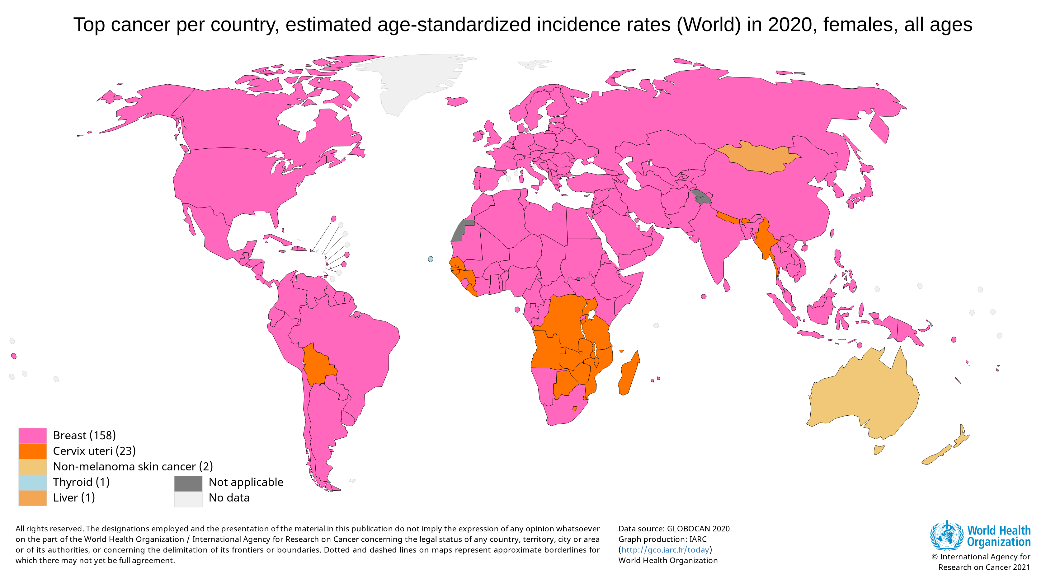
2. How common is breast cancer? (cont.)

Slide 6

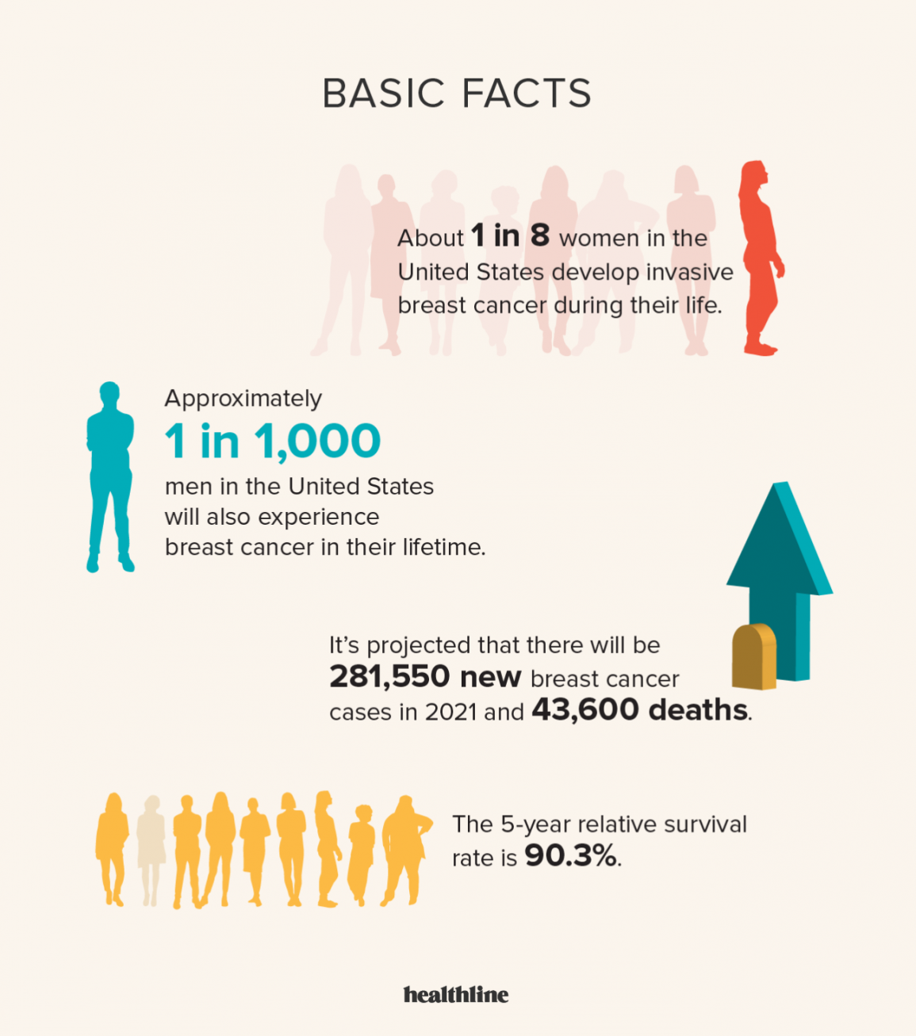
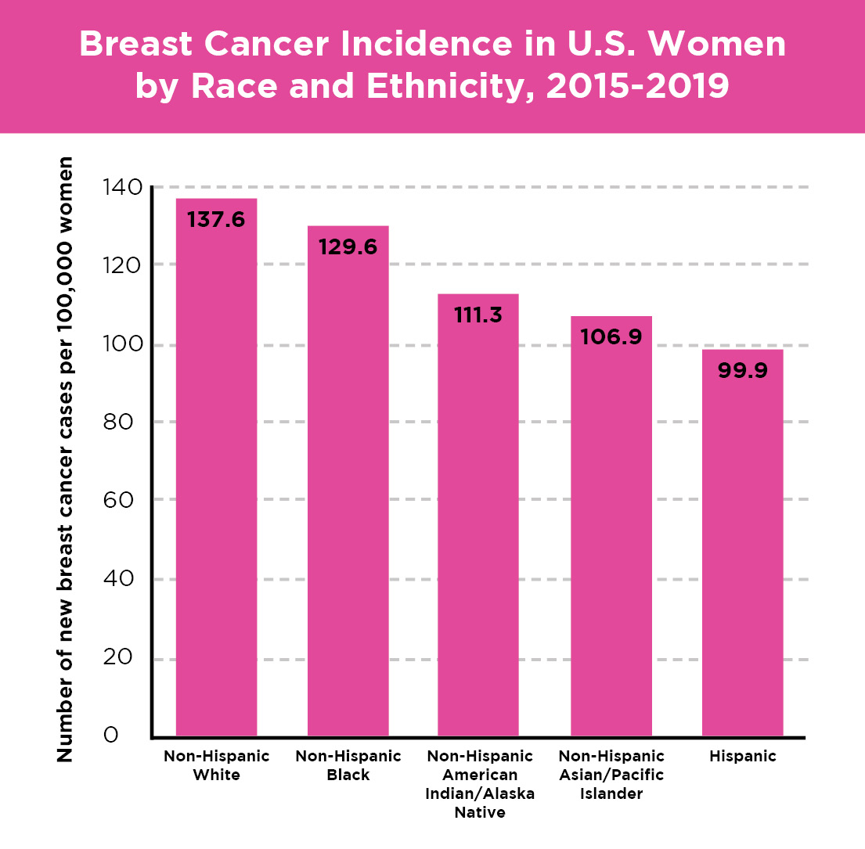
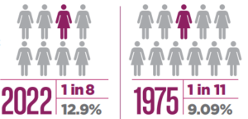
2. How common is breast cancer? (cont.)
Here are the American Cancer Society estimates for breast cancer in the United States for 2022:
About 13% (about 1 in 8) of U.S. women are going to develop invasive breast cancer in the course of their life ^{[4]}.
In 2022, an estimated 287,850 new cases of invasive breast cancer are expected to be diagnosed in women in the U.S., along with 51,400 new cases of non-invasive (in situ) breast cancer ^{[4]}.
About 2,710 new cases of invasive breast cancer are expected to be diagnosed in men in 2022. A man’s lifetime risk of breast cancer is about 1 in 833 ^{[4]}.
As of January 2022, there are more than 3.8 million women with a history of breast cancer in the U.S. This includes women currently being treated and women who have finished treatment ^{[4]}.
Breast cancer is the most commonly diagnosed cancer among American women ^{[4]} .
In 2022, it’s estimated that about 30% of newly diagnosed cancers in women are going to be breast cancers ^{[4]}.

Slide 7
3. General observations on diagnosis
Early detection is the key to reduce the death rate (40% or more) ^{[2]}.
The earlier the cancers are detected, the better treatment can be provided ^{[2]}.
However, early detection requires an accurate and reliable diagnosis which should also be able to distinguish benign and malignant tumors ^{[2]}.
A good detection approach should produce both low false positive (FP) rate and false negative (FN) rate ^{[2]}.
Although breast cancer incidence has increased over the past decade, breast cancer mortality has declined among women of all ages ^{[2]}.
Breast cancer may be detected via a cautious study of clinical history, physical examination, and imaging with either mammography or ultrasound ^{[1]}.
However, definitive diagnosis of a breast mass can only be established through fine-needle aspiration (FNA) biopsy, core needle biopsy, or excisional biopsy ^{[1]}.
Among these methods, FNA is the easiest and fastest method of obtaining a breast biopsy, and is effective for women who have fluid-filled cysts ^{[1]}.
FNA uses a needle smaller than those used for blood tests to remove fluid, cells, and small fragments of tissue for examination under a microscope ^{[1]}.
However, it is well known that expert radiologists can miss a significant proportion of abnormalities ^{[2]}.
Conventional methods of monitoring and diagnosing the diseases rely on detecting the presence of particular signal features by a human observer ^{[2]}.
In addition, a large number of mammographic abnormalities turn out to be benign after biopsy ^{[2]}.

Slide 8
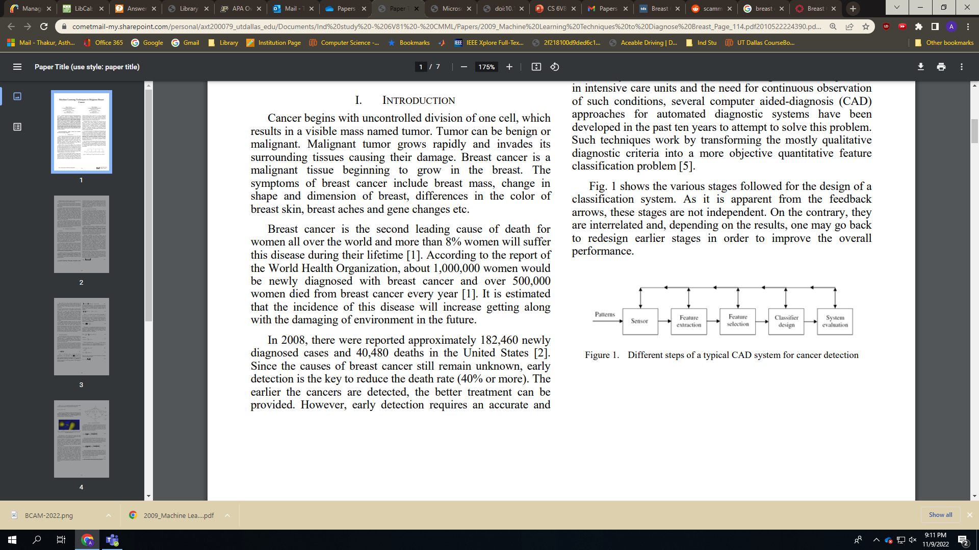
3. General observations on diagnosis (cont.)
Due to large number of patients in intensive care units and the need for continuous observation of such conditions, several computer aided-diagnosis (CAD) approaches for automated diagnostic systems have been developed in the past ten years to attempt to solve this problem ^{[2]}.
Such techniques work by transforming the mostly qualitative diagnostic criteria into a more objective quantitative feature classification problem ^{[2]}.
In 1998, the U. S. Food and Drug Administration (FDA) approved the first commercial CAD system for use as a second reader to assist in the detection of breast cancer in screening mammography ^{[22]}.
Below figure shows the various stages followed for the design of a classification system ^{[2]}.
As it is apparent from the feedback arrows, these stages are not independent ^{[2]}.
On the contrary, they are interrelated and, depending on the results, one may go back to redesign earlier stages in order to improve the overall performance ^{[2]}.

Slide 9
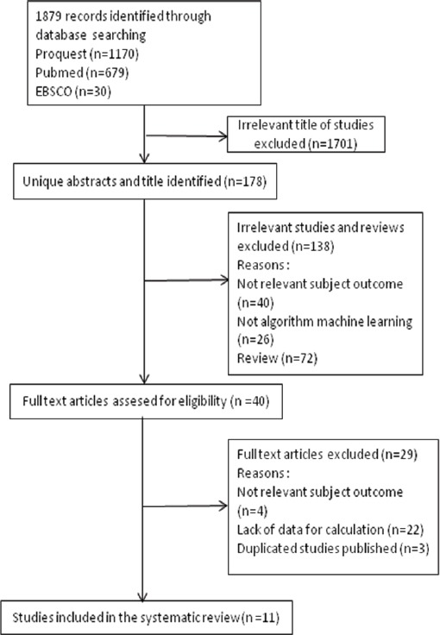



4. Diagnosis using ML : current practices
Several works on diagnosis were developed in the area of breast cancer.
A total of 1,879 articles were reviewed, of which 11 were selected for systematic review and meta-analysis ^{[18]}.
Five algorithms for machine learning able to predict breast cancer risk were identified: Super Vector Machine (SVM); Artificial Neural Networks (ANN); Decision Tree (DT); Naive Bayes (NB); and K-Nearest Neighbor (KNN) ^{[18]}.
With the SVM, the Area Under Curve (AUC) from the SROC was > 90%, therefore classified into the excellent category ^{[18]}.
Based on the experiment conducted till now, it shows that experienced physicians can detect cancer by 79% accuracy, while a 91% (sometimes up to 97%) accuracy can be achieved using Machine Learning techniques ^{[5]}.
Machine Learning technique can dramatically improve the level of diagnosis in breast cancer ^{[5]}.
Flow Diagram Research Procedure ^{[18]}

Slide 10
5. Cost-effectiveness of diagnosis using ML
Based on a model-based economic evaluation study, it used a hybrid decision tree/microsimulation model to compare the cost-effectiveness of eight strategies of mammography screening for women aged 40–49 (screening beyond age 50 follows existing guidelines) ^{[23]}.
Risk prediction using AI followed by no screening for low-risk women is the most cost-effective strategy ^{[23]}.
Strategy | Cost (in 1000 $) | Effectiveness (in QALYs) | No. (%) of true high risk women classified as high risk | No. (%) of true low risk women classified as low risk | No. of breast cancer deaths (per 100,000 women) | No. of false positive diagnoses (per 100,000 women)
No screening (No ML(AI)) | 1,745,808 | 1,976,720 | – | – | 3367 | 0
AI + no screening for low risk | 1,843,441 | 1,980,830 | 24,525 (57.0) | 49,122 (87.0) | 2956 | 141,339
AI + biennial screening for low risk | 1,910,153 | 1,978,604 | 24,525 (57.0) | 49,122 (87.0) | 2903 | 180,163
Annual screening for all | 2,022,120 | 1,978,717 | – | – | 2778 | 290,325
All costs are in 2020 US dollars ($). Costs and effectiveness are calculated per 100,000 women.

Slide 11
6. Systematic Review of Different ML Algorithms
The selection of studies was conducted to obtain 11 studies related to diagnostic test accuracy of different machine learning algorithms for breast cancer risk calculation ^{[18]}
First Author, Year | Size of Dataset (n) | Dataset | Machine Learning Algorithms | Accuracy (%) | NOS
Chang et al., 2003 | 250 | Primary data (pathologically proved breast tumors) | Super Vector Machine | 85.6 | 7
Polat and Gunes, 2007 | 683 | Wisconsin breast cancer dataset | Super Vector Machine | 95.89 | 7
Akay, 2009 | 683 | Wisconsin breast cancer dataset | Super Vector Machine | 99.51 | 7
Ayer et al., 2010 | 62,219 | Wisconsin state cancer reporting system | Artificial Neural Networks | 96.5 | 8
Dramicanin et al., 2012 | 42 | Primary data (breast tissue specimens) | Super Vector Machine | 64.29 | 6
Note: Super Vector Machine is same is Support Vector Machine

Slide 12
6. Systematic Review of Different ML Algorithms (cont.)
First Author, Year | Size of Dataset (n) | Dataset | Machine Learning Algorithms | Accuracy (%) | NOS
Subramanian et al., 2014​ | 40​ | Primary data (mammographic image)​ | a. Super Vector Machine​ b. Artificial Neural Networks​ c. Decision Tree​ d. Naive Bayes​ | a. 62.5​ b. 75​ c. 67.5​ d. 75​ | 6​
Mert et al., 2015​ | 569​ | Wisconsin diagnostic breast cancer dataset​ | a. K-Nearest Neighbor​ b. Artificial Neural Networks​ c. Radial Basis Function Neural Network​ d. Super Vector Machine​ | a. 93.14​ b. 97.53​ c. 87.17​ d. 95.25​ | 7​
Note: Super Vector Machine is same is Support Vector Machine

Slide 13
6. Systematic Review of Different ML Algorithms (cont.)
First Author, Year | Size of Dataset (n) | Dataset | Machine Learning Algorithms | Accuracy (%) | NOS
Milosevic et al., 2015​​ | 300​​ | The Mini Mammographic Database​​ | a. Super Vector Machine​​ b. K-Nearest Neighbor​​ c. Naive Bayes​​ | a. 83.7​​ b. 54.3​​ c. 77.3​​ | 7​​
Sun et al., 2015​​ | 340​​ | Primary data (digital mammograms)​​ | Super Vector Machine​​ | 72.9​​ | 7​​
Asri et al., 2016​​ | 699​​ | Wisconsin breast cancer dataset​​ | a. Support Vector Machine​​ b. Decision Tree​​ c. Naive Bayes​​ d. K-Nearest Neighbors​​ | a. 97.13​​ b. 95.13​​ c. 95.99​​ d. 95.27​​ | 8​​
Heidari et al., 2018​​ | 500​​ | Primary data (full-field digital mammography)​​ | Super Vector Machine​​ | 60.8​​ | 7​​
Note: Super Vector Machine is same is Support Vector Machine

Slide 14
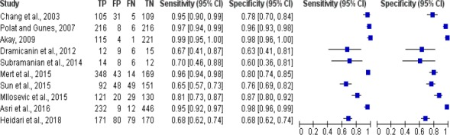
6. Systematic Review of Different ML Algorithms (cont.)
Forest Plot Breast Cancer Risk Calculation Using Super Vector Machine
There were 10 studies of breast cancer risk calculation using super vector machine algorithm, the sensitivity value of the algorithm was between 0.67 and 0.99, while the specificity value was 0.60 to 0.98 ^{[18]}
Study | TP | FP | FN | TN | Sensitivity (95% CI) | Specificity (95% CI) | Sensitivity (95% CI) | Specificity (95% CI)
Forest Plot Breast Cancer Risk Calculation Using Super Vector Machine

Slide 15
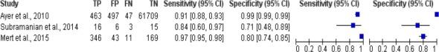
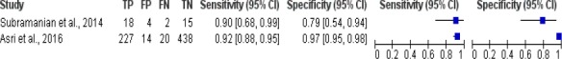
6. Systematic Review of Different ML Algorithms (cont.)
Forest Plot Breast Cancer Risk Calculation using other ML techniques
Study | TP | FP | FN | TN | Sensitivity (95% CI) | Specificity (95% CI) | Sensitivity (95% CI) | Specificity (95% CI)
Artificial Neural Network - sensitivity - between 0.84 and 0.97, specificity - 0.71 to 0.99
Study | TP | FP | FN | TN | Sensitivity (95% CI) | Specificity (95% CI) | Sensitivity (95% CI) | Specificity (95% CI)
Decision Tree - sensitivity - between 0.90 and 0.92, specificity - 0.79 to 0.97

Slide 16
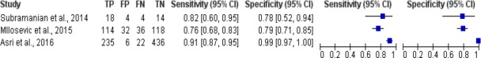
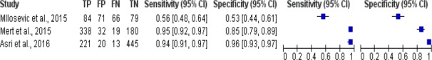
6. Systematic Review of Different ML Algorithms (cont.)
Forest Plot Breast Cancer Risk Calculation using other ML techniques (cont.)
Study | TP | FP | FN | TN | Sensitivity (95% CI) | Specificity (95% CI) | Sensitivity (95% CI) | Specificity (95% CI)
Naive Bayes - sensitivity - between 0.76 and 0.91, specificity - 0.78 to 0.99
Study | TP | FP | FN | TN | Sensitivity (95% CI) | Specificity (95% CI) | Sensitivity (95% CI) | Specificity (95% CI)
K-Nearest Neighbor - sensitivity - between 0.56 and 0.95, specificity - 0.53 to 0.96

Slide 17
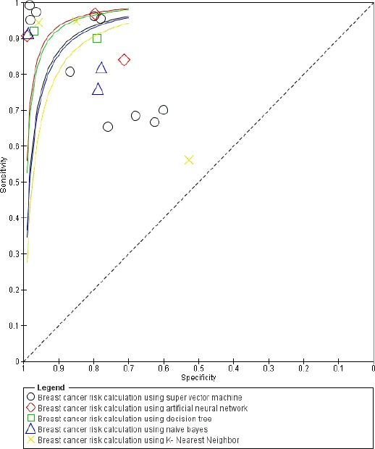
7. Most preferable ML technique – SVM
Summary Receiver Operating Characteristic (SROC) Plot Comparison of 5 different ML techniques
Figure shows there were 5 studies from 10 studies with Area Under Curve (AUC) > 90% which describes breast cancer risk calculation using super vector machine algorithm were classified into excellent category, while the other 5 studies were classified into good to fair category ^{[18]}.
One of 3 studies with AUC > 90% which describes breast cancer risk calculation using artificial neural network algorithm was classified into excellent category, while the other 2 studies were classified into good category (0.80 to 0.90) ^{[18]}.
One of 2 studies with AUC > 90% which describes breast cancer risk calculation using decision tree algorithm was classified into excellent category, while the another study was into good category (0.80 to 0.90) ^{[18]}.
One of 3 studies with AUC > 90% which describes breast cancer risk calculation using naive bayes algorithm was classified into excellent category, while the other 2 studies were classified into fair category (0.70 to 0.80) ^{[18]}.
There were 2 of 3 studies with AUC > 90% which describes breast cancer risk calculation using K-Nearest Neighbor algorithm that were classified into excellent category, while another study was classified into failure category (0.50 to 0.60) ^{[18]}.
Hence, after comparing all the 5 different ML techniques, we select SVM as the most preferable ML technique for Breast Cancer diagnosis
SROC Plot Breast Cancer Risk Calculation Using Machine Learning Algorithms ^{[18]}

Slide 18
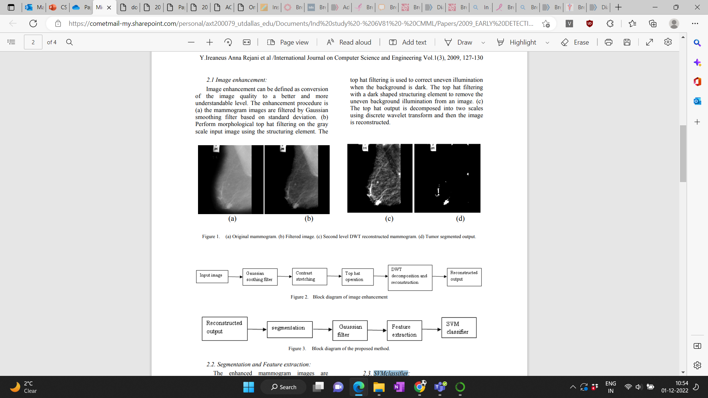
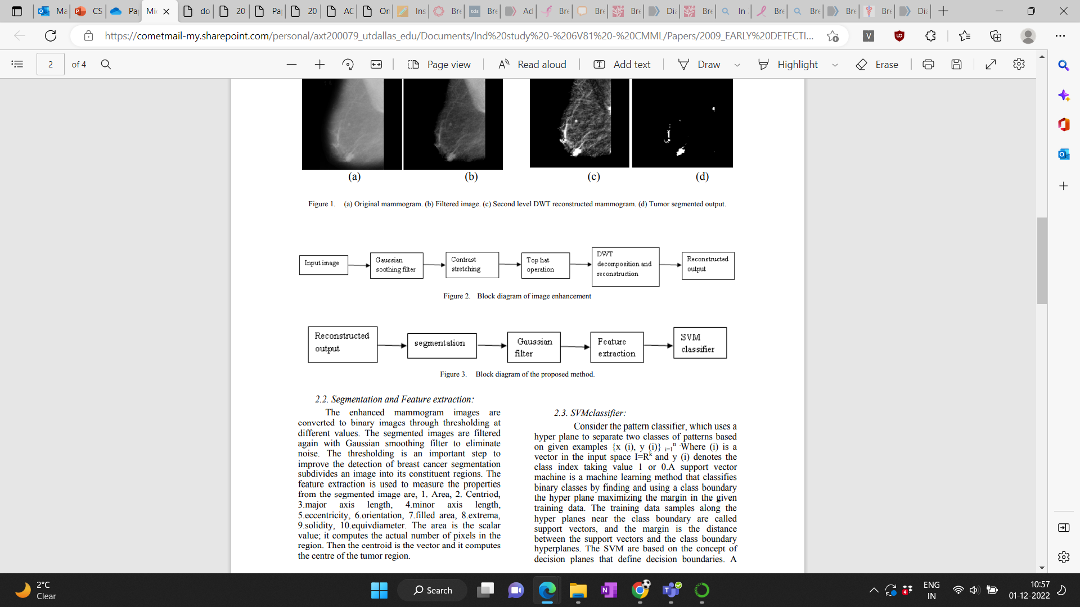
8. SVM in detection of tumors^{[17]}
Stages:
1. Image enhancement
Image enhancement can be defined as conversion of the image quality to a better and more understandable level ^{[17]}.

Slide 19
8. SVM in detection of tumors ^{[17]} (cont.)
2. Segmentation and Feature extraction
The enhanced mammogram images are converted to binary images through thresholding at different values ^{[17]}.
The segmented images are filtered again with Gaussian smoothing filter to eliminate noise ^{[17]}.
The thresholding is an important step to improve the detection of breast cancer segmentation subdivides an image into its constituent regions ^{[17]}.
The feature extraction is used to measure the properties from the segmented image tumor region ^{[17]}.
3. SVM classifier

Slide 20
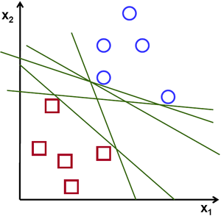

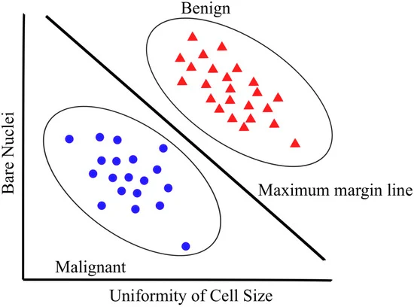
9. What is SVM?
Support vector machine (SVM) is highly preferred by many as it produces significant accuracy with less computation power and it can be used for both regression and classification tasks ^{[20]}.
It is widely used in classification objectives ^{[20]}.
The objective of the support vector machine algorithm is to find a hyperplane in an N-dimensional space(N — the number of features) that distinctly classifies the data points ^{[20]}.
Our objective is to find a plane that has the maximum margin, i.e the maximum distance between data points of both classes ^{[20]}.
Maximizing the margin distance provides some reinforcement so that future data points can be classified with more confidence ^{[20]}.
Possible hyperplanes ^{[20]}
A simple example of how an SVM might work in distinguishing between benign and malignant tumor ^{[24]}.

Slide 21
10. Advantages & Disadvantages of SVM ^{[5]}
The advantages of support vector machines are ^{[5]}:
Effective in high dimensional spaces ^{[5]}.
Still effective in cases where number of dimensions is greater than the number of samples ^{[5]}.
Uses a subset of training points in the decision function (called support vectors), so it is also memory efficient ^{[5]}.
Versatile: different kernel functions can be specified for the decision function. Common kernels are provided, but it is also possible to specify custom kernels ^{[5]}.
The disadvantages of support vector machines include ^{[5]}:
If the number of features is much greater than the number of samples, avoid over-fitting in choosing kernel functions and regularization term is crucial ^{[5]}.
SVMs do not directly provide probability estimates, these are calculated using an expensive five-fold cross-validation ^{[5]}.

Slide 22
11. Breast Cancer Classification using SVM
Aim: To classify tumors into malignant (cancerous) or benign (non-cancerous) using features obtained from several cell images ^{[5]}.
Features are computed from a digitized image of a fine needle aspirate (FNA) of a breast mass. They describe characteristics of the cell nuclei present in the image ^{[5]}.
Dataset Information:
Dataset used : Wisconsin Breast Cancer Data Set
Date donated : 1992-07-15 ^{[26]}
Creator ^{[26]}: Dr. William H. Wolberg (physician) University of Wisconsin Hospitals Madison, Wisconsin, USA Donor ^{[26]}: Olvi Mangasarian Received by David W. Aha

Slide 23
Ten real-valued features are computed for each cell nucleus ^{[5]}:
12. Attribute information and Features
Attribute Information [5]:
ID number [5]
Diagnosis (M = malignant, B = benign) [5]
Radius (mean of distances from center to points on the perimeter)
Texture (standard deviation of gray-scale values)
Perimeter
Area
Smoothness (local variation in radius lengths)
Compactness (perimeter² / area — 1.0)
Concavity (severity of concave portions of the contour)
Concave points (number of concave portions of the contour)
Symmetry
Fractal dimension (“coastline approximation” — 1)

Slide 24
13. Algorithm^{[5]}
Import libraries and breast cancer dataset
View data in dataframe
Features breakdown
Visualize the relationship between features
Check the correlation between features
Model Training:
From the dataset, create the target and predictor matrix
“y” = Is the feature we are trying to predict (Output). In this case we are trying to predict if our “target” is cancerous (Malignant) or not (Benign). i.e. we are going to use the “target” feature here.
“X” = The predictors which are the remaining columns (mean radius, mean texture, mean perimeter, mean area, mean smoothness, etc.)
Create the training and testing data
Training data = the subset of our data used to train our model.
Testing data = the subset of our data that the model hasn’t seen before (We will be using this dataset to test the performance of the model).
Split the data - 80% for training and the remaining 20% for testing.
Import Support Vector Machine (SVM) Model
Train SVM Model using training dataset
Use trained model to make prediction using testing data
Check the accuracy of our prediction by comparing it to the output we already have (y_test). We are going to use confusion matrix for this comparison.
Create a confusion matrix for classifier’s performance on the test dataset.
Visualize confusion matrix on a Heatmap

Slide 25
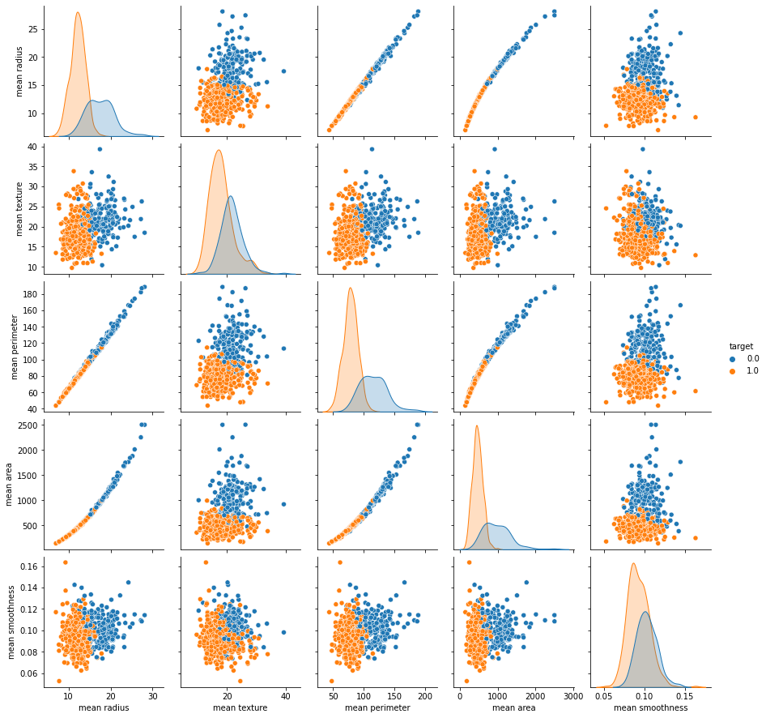
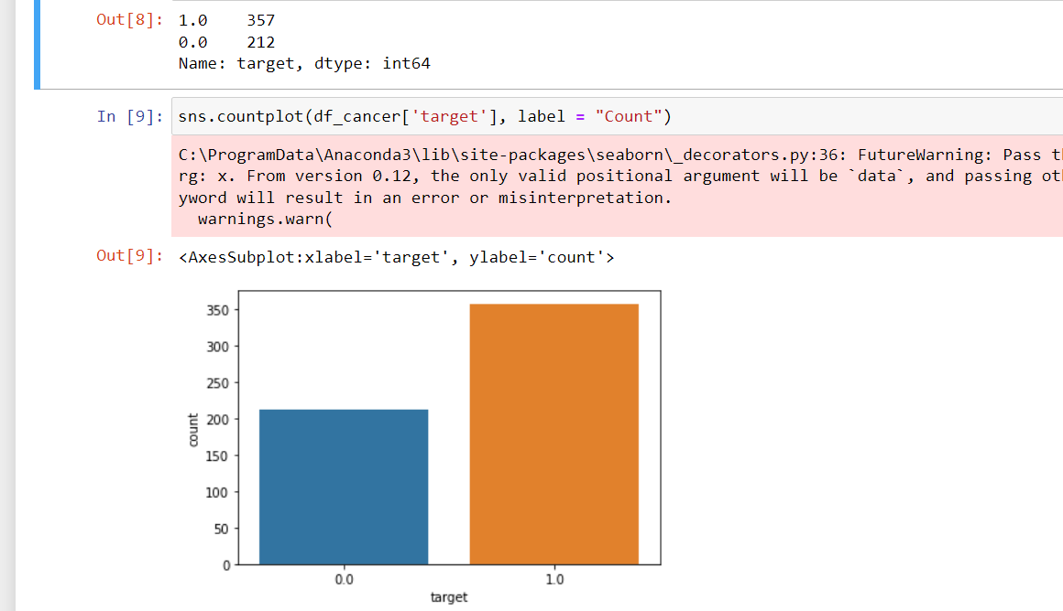
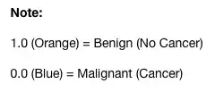
14. Results
Visualizing relationship between features - Plotting out just the first 5 variables (features)
Target count

Slide 26
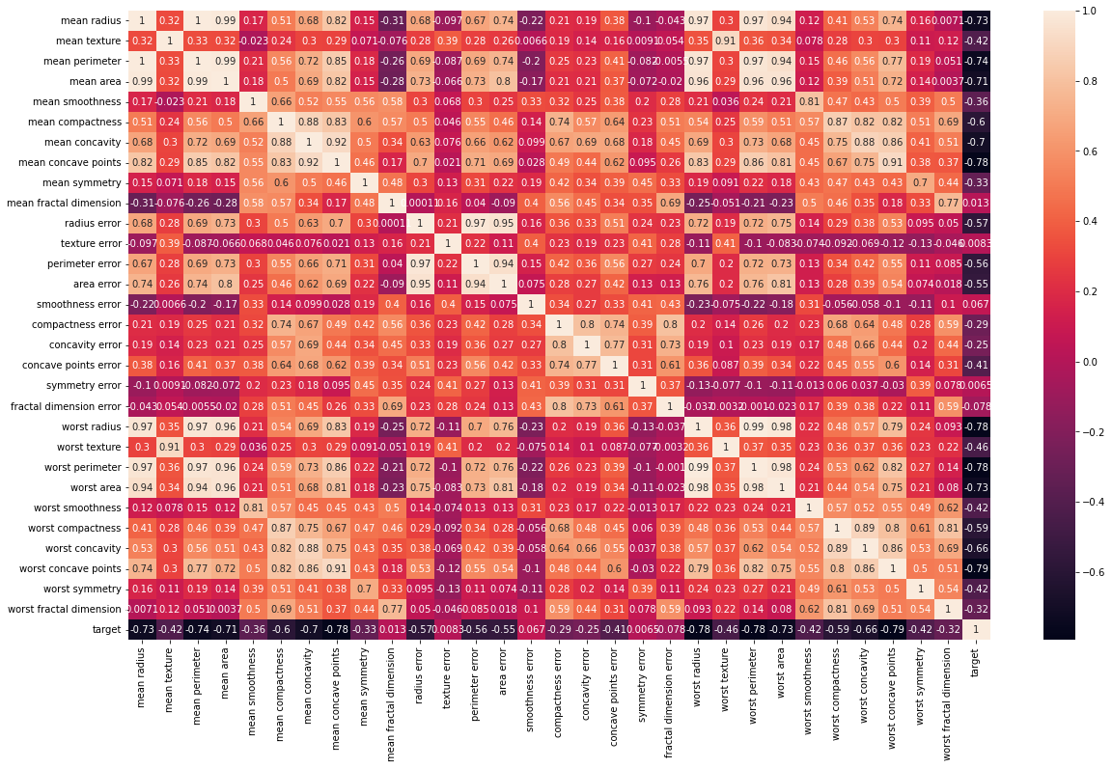
Correlation between features
14. Results​ (cont.)

Slide 27
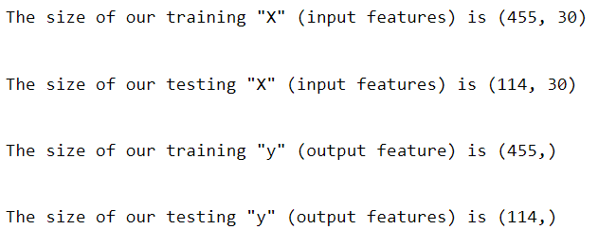
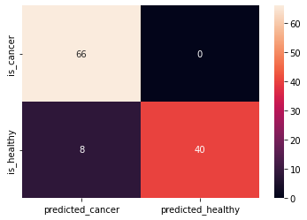
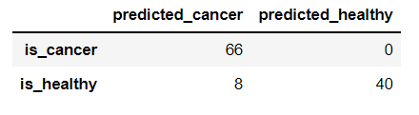
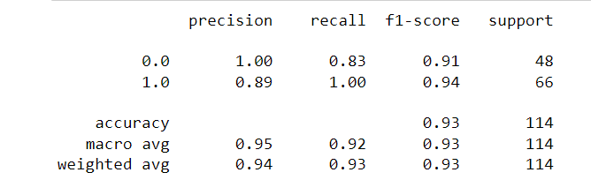
14. Results​ (cont.)
Train-test divide of dataset
Heat map of confusion matrix​
Confusion matrix
Classification report
This gives a 94% accuracy

Slide 28
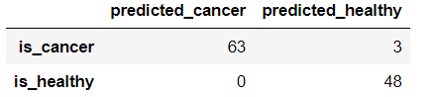
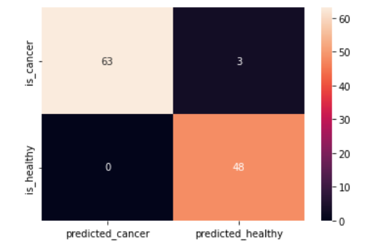
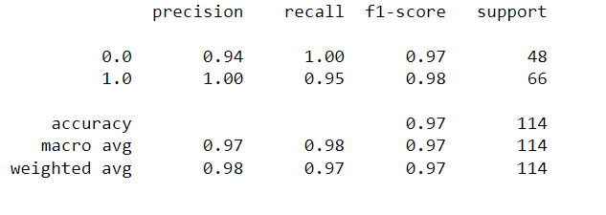
15. Improvements in the model
Normalize data
Data normalization is a feature scaling process that brings all values into range [0,1]
X’ = (X-X_min) / (X_max — X_min)
Train SVM model with scaled (Normalized) datasets
Prediction with Scaled dataset
Confusion Matrix on Scaled dataset
Heat map of confusion matrix​
Confusion matrix
Classification report
We achieved 98% accuracy!

Slide 29
16. Risk of misdiagnosis
Nowadays, healthcare informatics is mainly focusing on the classification of breast cancer images, due to the lethal nature of this cancer. There are chances of inter- and intra-observer variability that may lead to misdiagnosis in the detection of cancer ^{[26]}.
When using the SVM, three obstacles can be confronted: how to choose the kernel function and optimal input feature subset for SVM, and how to set the best kernel parameters ^{[27]}.
These obstacles are crucial because the feature subset choice influences the appropriate kernel parameters and vice versa ^{[27]}.
Feature selection is an important issue in building classification systems ^{[27]}.
It is advantageous to limit the number of input features in a classifier to in order to have a good predictive and less computationally intensive model ^{[27]}.
Building a model that can handle the three obstacles at the same time is a very important issue and needs further research and work in the future ^{[27]}.

Slide 30
17. Summary
Breast cancer is one of the most common cancers in the world.
Early detection will increase the chances of survival.
The traditional way of diagnosing the breast cancer involves a lot of pain and money for the patient, instead we can use computer aided diagnosis along with the traditional ways to increase the accuracy of diagnosis and elimination of human error.
Machine learning can be used in computer aided diagnosis techniques to increase the accuracy.
There are a lot of ML techniques which have been experimented in the past for diagnosis, out of these SVM comes out as one of the consistent ML technique for breast cancer classification.
Though SVM gives high accuracy, there are certain risks of misdiagnosis.
Hence, SVM should just be used as a tool to assist with diagnosis and should not be used as a standalone way of diagnosis.

Slide 31
References
Tingting Mu, Asoke K. Nandi, Breast cancer detection from FNA using SVM with different parameter tuning systems and SOM–RBF classifier, Journal of the Franklin Institute 344 (2007, Published by Elsevier Ltd, pp.285–311. doi: 10.1016/j.jfranklin.2006.09.005
Alireza Osareh, Bita Shadgar, Machine Learning Techniques to Diagnose Breast Cancer, 5th International Symposium on Health Informatics and Bioinformatics, Ankara, Turkey, 20-22 April 2010, IEEE Xplore Accession Number: 11441676. doi: 10.1109/HIBIT.2010.547889
Basavaraj Hiremath , SC Prasannakumar, Automated Evaluation of Breast Cancer Detection Using SVM Classifier , International Journal of Computer Science Engineering And Information Technology Research (IJCSEITR, ISSN(P): 2249-6831), Vol. 5, Issue 1, Feb 2015, pp. 11-20
https://www.breastcancer.org/facts-statistics
https://towardsdatascience.com/breast-cancer-classification-using-support-vector-machine-svm-a510907d4878
https://gco.iarc.fr/
https://www.cancer.gov/about-nci/organization/cgh/blog/2017/breast-cancer
https://www.uicc.org/what-we-do/thematic-areas-work/breast-cancer
https://www.komen.org/breast-cancer/facts-statistics/breast-cancer-statistics/
https://www.nationalbreastcancer.org/breast-cancer-facts
https://www.stopbreastcancer.org/information-center/facts-figures/
https://www.healthline.com/health/breast-cancer/breast-cancer-facts
https://twitter.com/who/status/1184122342831742976
https://www.ncbi.nlm.nih.gov/pmc/articles/PMC6165638/
Breast Cancer Statistics And Resources | BCRF
Breast Cancer - StatPearls - NCBI Bookshelf (nih.gov)
Y.Ireaneus Anna Rejani , S.Thamarai Selvi, Early Detection of Breast Cancer Using SVM Classifier Technique, International Journal on Computer Science And Engineering, Vol.1(3), 2009, pp. 127-130
https://www.ncbi.nlm.nih.gov/pmc/articles/PMC6165638/
https://www.sciencedirect.com/science/article/pii/S2667102621000887#:~:text=Based%20on%20the%20results%20of,varied%20between%200.03%20and%200.06.
https://towardsdatascience.com/support-vector-machine-introduction-to-machine-learning-algorithms-934a444fca47
https://www.cancerresearchuk.org/about-cancer/cancer-symptoms
https://www.ncbi.nlm.nih.gov/pmc/articles/PMC7293164/
https://bmccancer.biomedcentral.com/articles/10.1186/s12885-022-09613-1
https://www.mdpi.com/2411-9660/2/2/13
https://archive.ics.uci.edu/ml//datasets/Breast+Cancer+Wisconsin+%28Original%29
https://pubmed.ncbi.nlm.nih.gov/34302269/
https://www.sciencedirect.com/science/article/pii/S1110866510000241

Slide 32
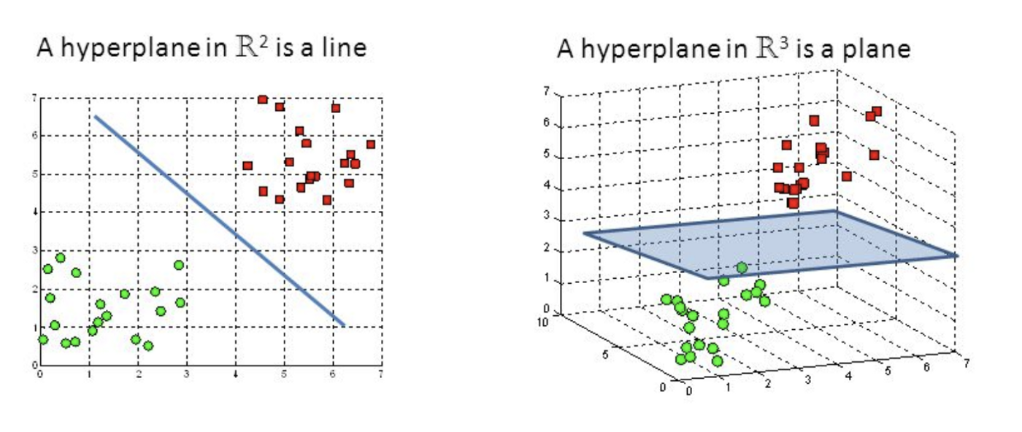
Hyperplanes and Support Vectors ^{[20]}
Appendix
More about SVM
Hyperplanes are decision boundaries that help classify the data points ^{[20]}.
Data points falling on either side of the hyperplane can be attributed to different classes ^{[20]}.
Also, the dimension of the hyperplane depends upon the number of features ^{[20]}.
If the number of input features is 2, then the hyperplane is just a line ^{[20]}.
If the number of input features is 3, then the hyperplane becomes a two-dimensional plane ^{[20]}.
It becomes difficult to imagine when the number of features exceeds 3 ^{[20]}.
Hyperplanes in 2D and 3D feature space ^{[20]}

Slide 33
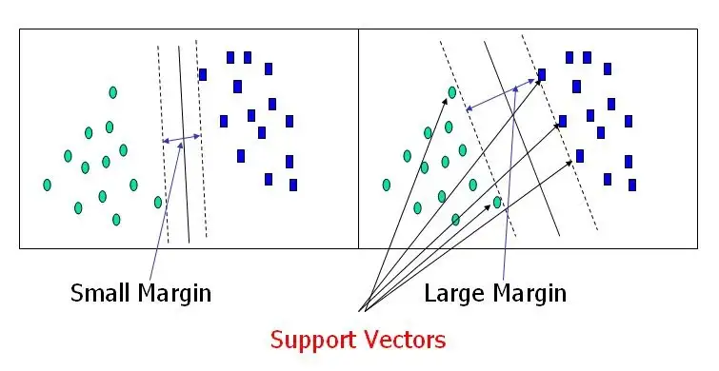
Hyperplanes and Support Vectors (cont.) ^{[20]}
Support vectors are data points that are closer to the hyperplane and influence the position and orientation of the hyperplane ^{[20]}.
Using these support vectors, we maximize the margin of the classifier ^{[20]}.
Deleting the support vectors will change the position of the hyperplane ^{[20]}.
These are the points that help us build our SVM ^{[20]}.
Support Vectors ^{[20]}

Slide 34
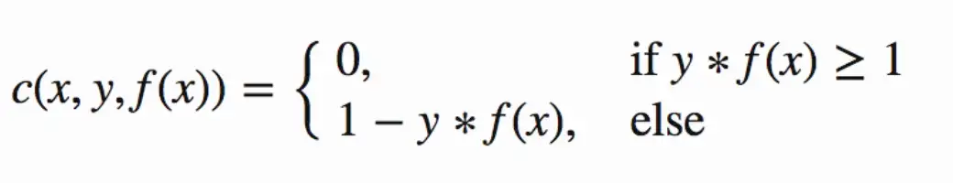
Large Margin Intuition ^{[20]}
In logistic regression, we take the output of the linear function and squash the value within the range of [0,1] using the sigmoid function ^{[20]}.
If the squashed value is greater than a threshold value(0.5) we assign it a label 1, else we assign it a label 0 ^{[20]}.
In SVM, we take the output of the linear function and if that output is greater than 1, we identify it with one class and if the output is -1, we identify is with another class ^{[20]}.
Since the threshold values are changed to 1 and -1 in SVM, we obtain this reinforcement range of values([-1,1]) which acts as margin ^{[20]}.
Cost Function and Gradient Updates ^{[20]}
In the SVM algorithm, we are looking to maximize the margin between the data points and the hyperplane. The loss function that helps maximize the margin is hinge loss ^{[20]}.
Hinge loss function ^{[20]}

Slide 35
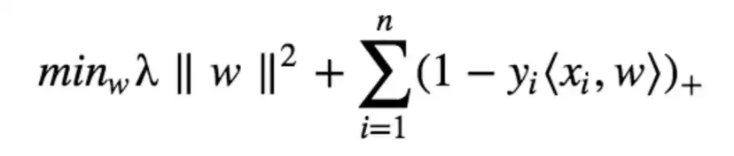
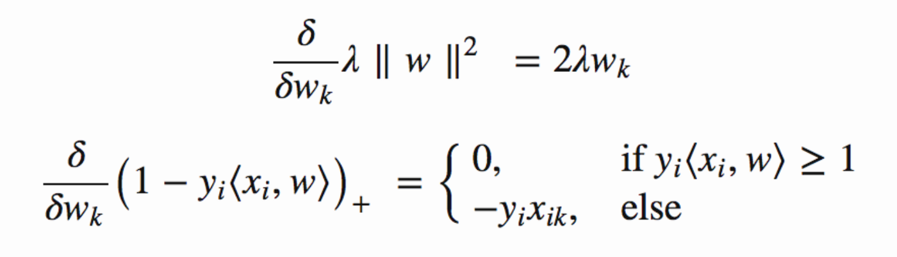
Cost Function and Gradient Updates (cont.)^{[20]}
The cost is 0 if the predicted value and the actual value are of the same sign ^{[20]}.
If they are not, we then calculate the loss value ^{[20]}.
We also add a regularization parameter the cost function ^{[20]}.
The objective of the regularization parameter is to balance the margin maximization and loss ^{[20]}.
After adding the regularization parameter, the cost functions looks as below ^{[20]}.
Now that we have the loss function, we take partial derivatives with respect to the weights to find the gradients. Using the gradients, we can update our weights ^{[20]}.
Loss function for SVM ^{[20]}
Gradients ^{[20]}

Slide 36
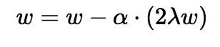
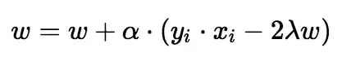
Cost Function and Gradient Updates (cont.)^{[20]}
When there is no misclassification, i.e our model correctly predicts the class of our data point, we only have to update the gradient from the regularization parameter ^{[20]}.
When there is a misclassification, i.e our model make a mistake on the prediction of the class of our data point, we include the loss along with the regularization parameter to perform gradient update ^{[20]}.
Gradient Update — No misclassification ^{[20]}
Gradient Update — Misclassification ^{[20]}

